Slide 1

Employee Attrition Analysis
Final Business Report & Retention Strategy

Slide 2
Executive Findings
17.25%
The Cost of Turnover
Employee turnover represents a major challenge for organizations because it increases recruitment costs and disrupts team productivity.
Company Attrition Rate
Most importantly, it results in the loss of valuable organizational knowledge. The dataset indicates that approximately 17.25% of employees left the company, while 82.75% remained.

Slide 3






Key Attrition Drivers
Excessive Overtime
Early-Career Stage
Lower Compensation
Employees working overtime consistently exhibit a much higher likelihood of leaving the organization than employees with normal working schedules.
Attrition is heavily concentrated among junior employees and those with short company tenure, before they become fully established.
Employees who resigned generally earn lower monthly salaries. Salary appears to be a critical, though not sole, retention factor.

Slide 4






Additional Attrition Drivers
Frequent Travel
Low Job Satisfaction
Marital Status
Employees who travel frequently experience noticeably higher attrition, likely due to stress, fatigue, and reduced work-life balance.
Employees with low job satisfaction leave at considerably higher rates. Improving the employee experience is crucial for retention.
Single employees experience the highest attrition among all marital groups, suggesting demographic characteristics contribute to patterns.

Slide 5


Project Objectives
The core objectives of this analytical project were to:
•
Assess overall employee attrition rates.
•
Clean and prepare raw HR data for analysis.
•
Identify the strongest drivers of employee turnover.
•
Generate actionable, data-driven business recommendations.
•
Prepare the dataset for future predictive machine learning models.

Slide 6


Data Preparation
Cleaning & Imputation
Processing & Scaling
Duplicate Removal: Duplicate employee records were identified and removed.
Removing Columns: Dropped variables with no analytical value (EmployeeCount, StandardHours, Over18,RecordID,EmployeeNumber,ManagerNotes).
Missing Values: Replaced using the median (Age, Income, YearsAtCompany) and mode (EducationField, JobRole).
Outlier Treatment: Extreme observations removed using the IQR method (Age, Income, DistanceFromHome).
Standardization: Corrected inconsistent formatting (e.g., "sales" → "Sales", "Sales Ex." → "Sales Executive").
Encoding & Scaling: Applied Label Encoding and One-Hot Encoding. Features were scaled using StandardScaler.

Slide 7
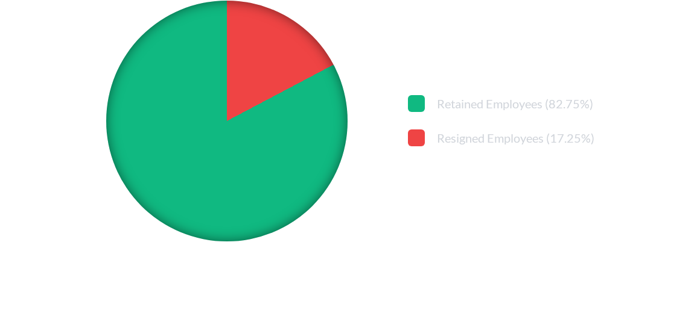
Overall Attrition Rate
Only a minority of employees left the organization. However, when evaluated proportionally, Human Resources and Sales experience higher attrition rates than Research & Development.

Slide 8
Employee Risk Profile
High-Risk Characteristics The employees most likely to leave typically share several key traits: They work overtime, frequently travel, earn relatively lower salaries, are in the early stages of their careers, have lower job satisfaction, and are single.
Retention Indicators Conversely, employees with longer tenure, higher salaries, no overtime requirements, and greater job satisfaction demonstrate significantly higher retention rates.
The Role of Training Employees who received no training during the previous year experienced the highest attrition. Training appears to directly support employee engagement and long-term retention.

Slide 9

Feature Engineering
New Feature | Business Purpose & Definition
ExperienceLevel | Categorizes employees into Junior, Mid, Senior, and Expert groups for targeted analysis.
TenureGroup | Groups employees based on the total number of years spent actively working in the company.
PromotionRate | Measures employee progression based on years at the company relative to the time since their last promotion.
HighIncome | A binary indicator showing whether an employee earns above or below the company's median salary.

Slide 10



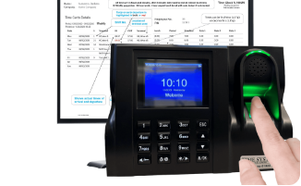

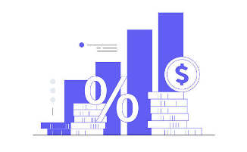
Business Recommendations
Reduce Overtime
Strengthen Retention
Review Compensation
Monitor overtime continuously and introduce flexible scheduling or compensatory leave to reduce burnout.
Implement structured onboarding programs and regular follow-up meetings during employees' first years.
Benchmark salaries against market standards, particularly for junior employees, to remain competitive.

Slide 11
Future Work & Next Steps
The cleaned dataset is now fully optimized and suitable for predictive machine learning.
Logistic Regression • Decision Tree • Random Forest • XGBoost
A predictive attrition model will help HR proactively identify employees at high risk of resignation and intervene before turnover occurs.

